Slide 1
Design Report 2 Presentation -
Bray Embedded Valves and Actuators
Team: Avery Haynes, Locke Lehmann, Travis Carlson, Cody Sims, Zachary Walker, Michael Hager
10/30/2023

Slide 2
Introduction
Bray is one of the world's premier manufacturers of flow control and automation products and accessories.
This semester, our team was assigned to work with Bray to develop a method to internally measure valve position independent of an actuator, measure actuator output torque, and detect fluid leakage to increase the valve's service life.
Bray currently has an external solution for measuring actuator output torque from the stem's reaction forces, but finding an internal solution would be more beneficial for Bray.
Notes:
Micheal

Slide 3
Problem
Need to measure valve directly, not actuator, due to hysteresis
Need to measure output torque, not torque on valve, due to stem deformation
SNPS: Develop a method to internally measure valve position independent of an actuator, measure actuator output torque, and detect fluid leakage to increase the service life of the valve.
Notes:
Zack

Slide 4
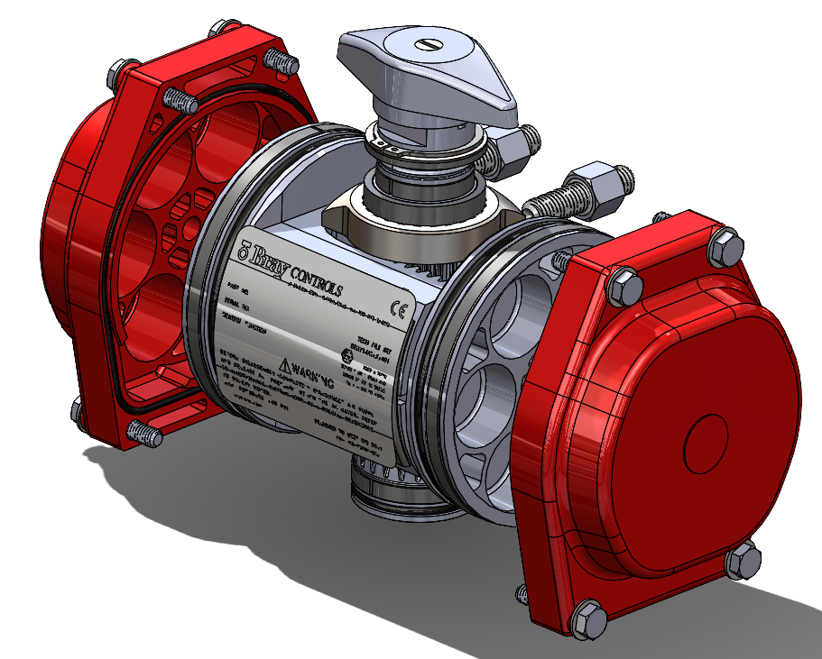
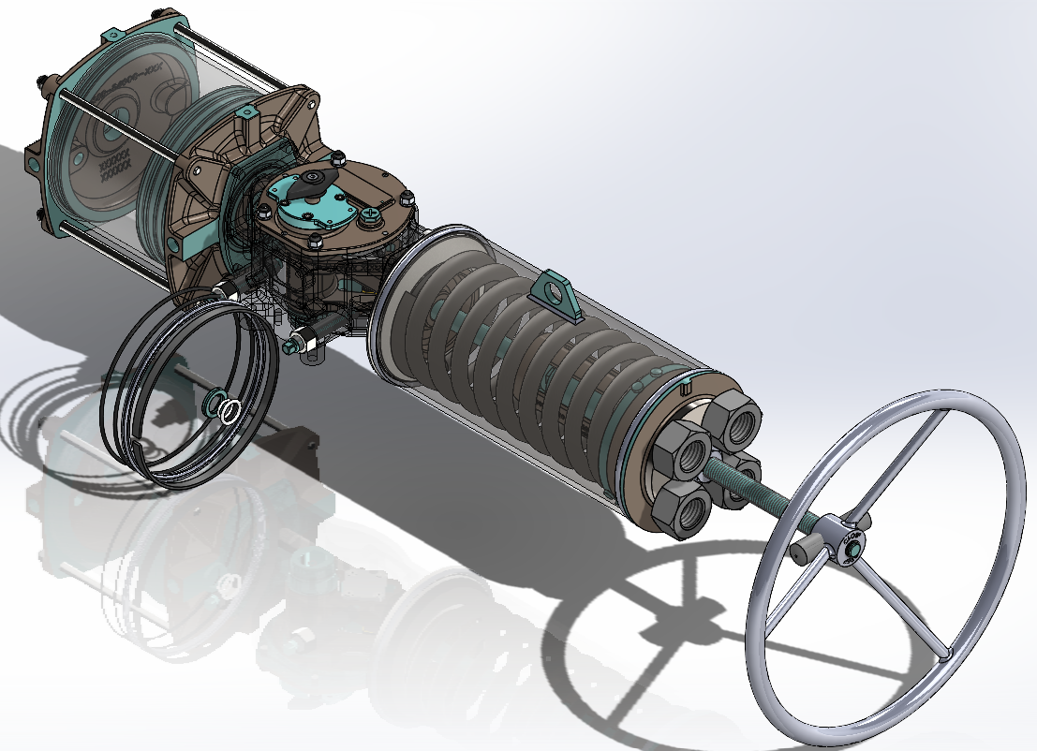
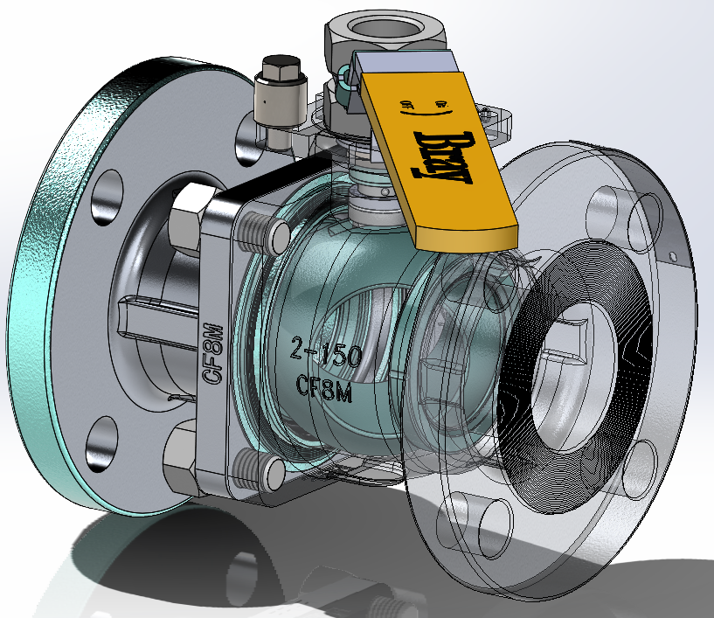
Problem
Notes:
Zack

Slide 5
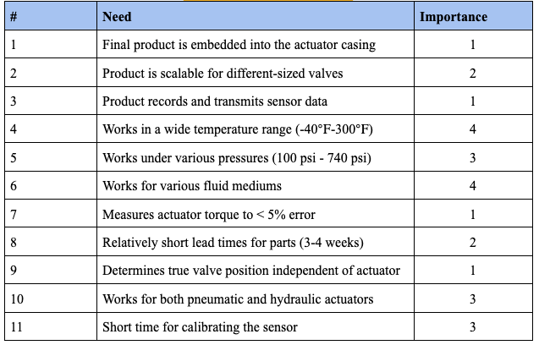
Customer Needs
Customer Needs Table
1 = Most Important, 4 = Least Important
A solution for valve leakage is no longer being explored
Notes:
Travis

Slide 6
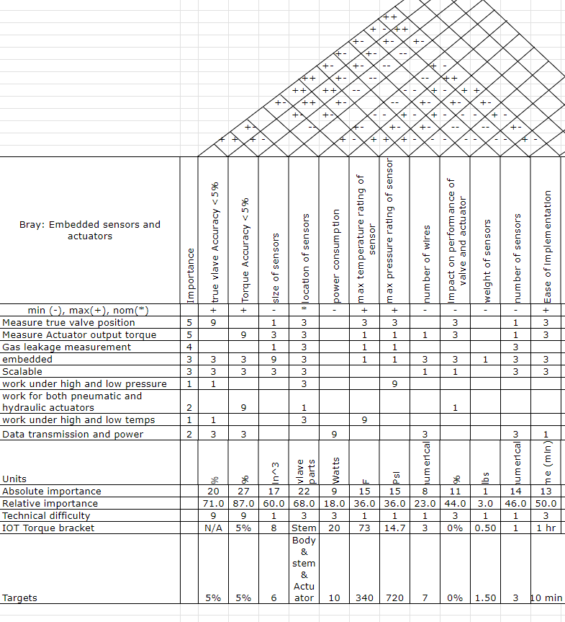
Design Requirements - HOQ
Top 3 metrics: valve position accuracy, torque accuracy, and location of sensors
Least important metrics: Weight of sensors, number of wires, and power consumption
Design needs to be compact due to the relationship between ease of implementation and weight size and number of sensors
Balance accuracy and power consumption.
Notes:
Locke

Slide 7
Design Requirements - Codes and Ethics
Design cannot compromise the valve meeting codes and standards.
Chose hazardous fluids code because it has stricter requirements
To meet items b and c design requirement of cannot be in contact with the fluid.
The valve must be of a sound engineering design.
Materials subject to the internal pressure of the pipeline system, including welded and flanged ends, must be compatible with the pipe or fittings to which the valve is attached.
Each part of the valve that will be in contact with the carbon dioxide or hazardous liquid stream must be made of materials that are compatible with carbon dioxide or each hazardous liquid that it is anticipated will flow through the pipeline system.
Each valve must be both hydrostatically shell tested and hydrostatically seat tested without leakage to at least the requirements set forth in section 11 of API Standard 6D (incorporated by reference, see §195.3).
Transportation of Natural and Other Gas by Pipeline, section 49, CFR 192.145
Notes:
locke

Slide 8
Requirements Checklist
Category | Requirements
Geometry | Size of sensor must be smaller than 5in^2 to be embedded; One sensor solution for each deliverable; location either inside the valve casing, stem, or actuator casing
Kinematics | Measure rotational motion, find velocity and acceleration of the actuator
Forces | Withstand maximum force of the actuator, about 150 lbs; if using dynamics, must find moment of inertia for the ball and stem system; account for deformation
Energy | Store enough energy for sensors for at least a year; input electrical energy
Material | If a sensor is in contact with the fluid, it must withstand pressure, temperature, and hazardous fluids; high strength, and low deformation to withstand millions of cycles of use.
Signal | Transmit easy-to-read data collected from sensors, user-friendly display
Production | Limited to size of valve casing, preferred production is metal 3D printing, low tolerance between ball and the valve casing
Quality control | Measurement accuracy below 5% error
Operation | Have a sensor life of a minimum of 20 years, market area: smart valve
Maintenance | Access point to service the sensor, Low inspection interval
Costs | Balance cost and accuracy of the sensor with upper sensor limit = $300
Notes:
Locke

Slide 9
Design Requirements
Req,t # | Need # | Metric | Imp | Required Values | Units
1 | 7, 9, 10 | Measurement Accuracy | 5 | < 5 | %
2 | 1, 2, 4, 5, 6 | Location of sensors | 4 | Valve casing, Stem, Actuator casing | N/A
3 | 3 | Lifetime of sensors | 3 | > 20 | years
4 | 8 | Ease of maintenance | 2 | < 4 | Moving parts
5 | 2, 11 | Ease of implementation | 3 | < 2 | hours
6 | 11 | Calibration Time | 3 | < 2 | hours
7 | 1, 2 | Volume of apparatus | 1 | < 5 | in2
8 | 3 | Power consumption | 1 | < 100 | Watt hours
Notes:
Locke

Slide 10
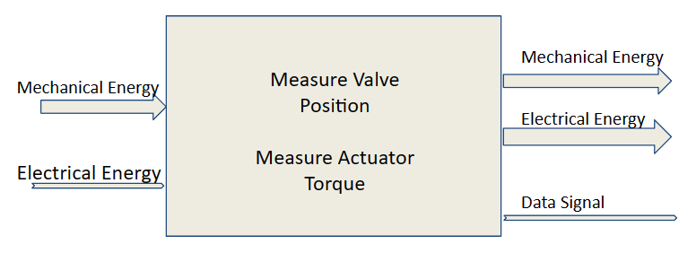
Functional Modeling - Black Box
Black Box Model
Identifies energy flows into/ out of the system
Basic Requirements to accomplish essential functions
Essential Functions:
Detect Valve Motion
Measure Actuator Torque
Notes:
Avery

Slide 11
Functional Modeling - Matching CNs
Customer Needs | Associated Flows
Final product is embedded into the actuator casing
Product is scalable for different-sized valves
Product records and transmits sensor data | Signal, Electrical
Works in a wide temperature range (-40℉-300℉)
Works under various pressures (100 psi - 740 psi)
Works for various fluid mediums | Mechanical
Measures actuator torque to < 5% error | Electrical
Relatively short lead times for parts (3-4 weeks)
Determines true valve position independent of actuator | Electrical, Signal
Works for both pneumatic and hydraulic actuators | Mechanical
Short time for calibrating the sensor | Electrical, Signal
Flows matched with CN table
Ensures each customer need is accounted for with current energy flows
CNs without flows are design constraints, not operational requirements

Slide 12
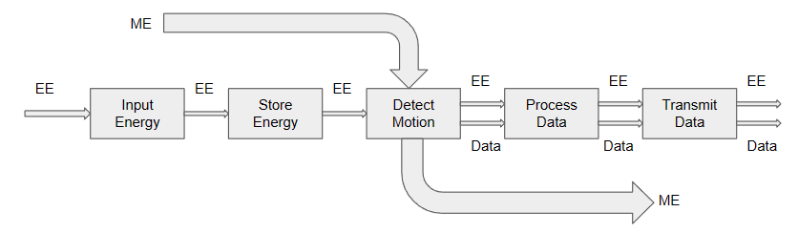
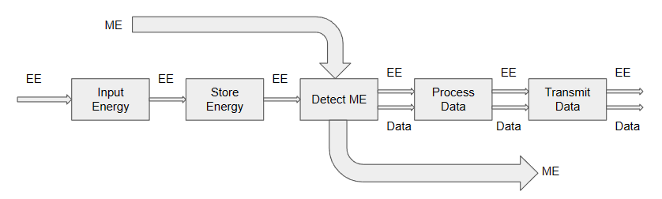
Functional Modeling - Function Chains
Connect Energy Flows to Sub-Functions within Product
“Zen Approach”
Chains split for the two deliverables
Detect the change in ME for determining position
Measure the ME for determining Torque
Position Measurement Function Chain
Torque Measurement Function Chain

Slide 13
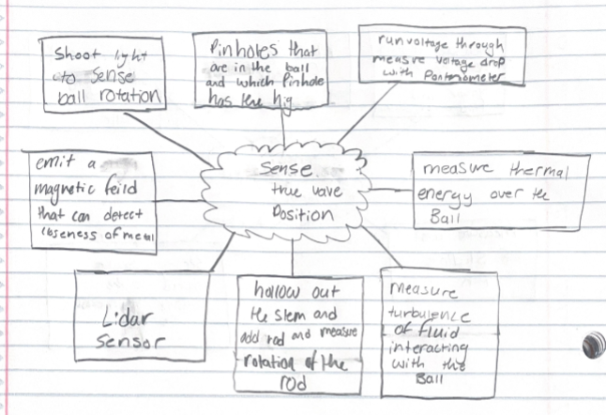
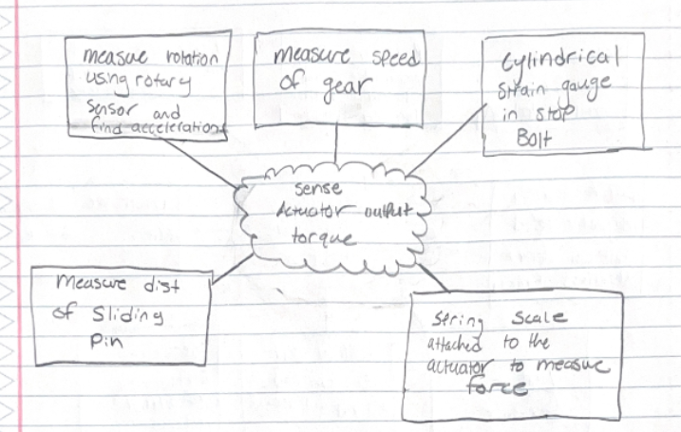
Idea Generation - Brainstorming
“No bad ideas” rule, mind-mapped ideas
Notes:
Zack

Slide 14
Idea Generation - TRIZ
Conflicts:
Volume of sensors
Accuracy of measurements
Energy consumption
User-friendliness/level of automation
Design Principles:
Mechanics substitution
Parameter changes
Phase transitions
Merging components
Notes:
Travis

Slide 15
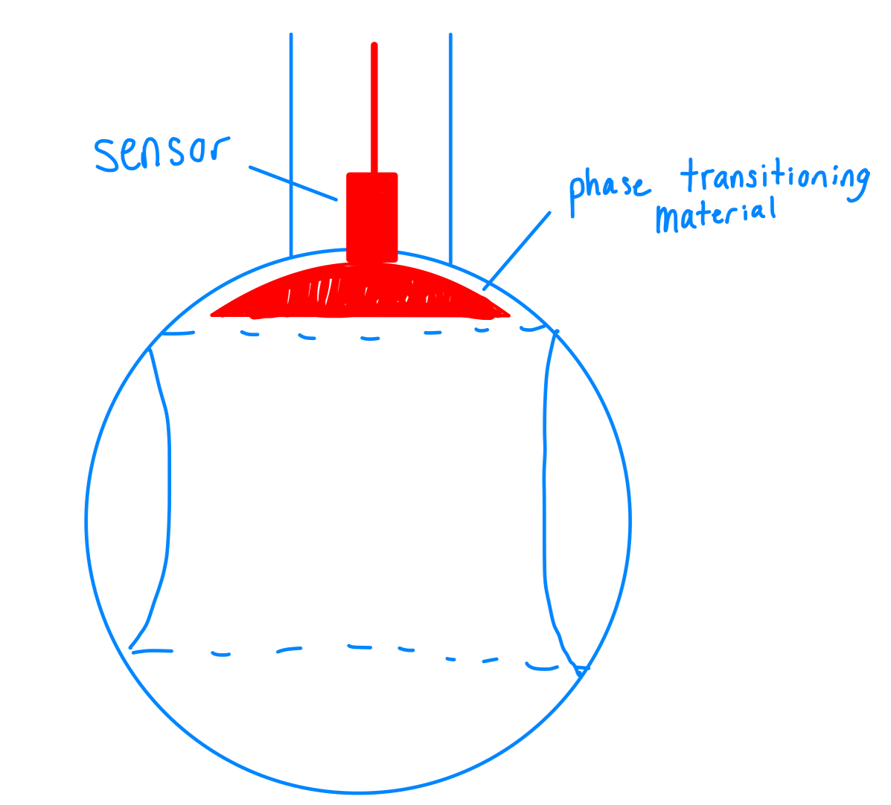
Idea Generation - TRIZ
Determine position utilizing sensors and phase transition material properties
Ball core is filled with special material, changes phase in accordance with heat as ball is opened/closed
Sensor detects change in phase, assigns corresponding value for position
TRIZ method typically led us toward indirect measurement methods, would involve series of data conversions
Bray desires a direct measurement solution
Notes:
Travis

Slide 16
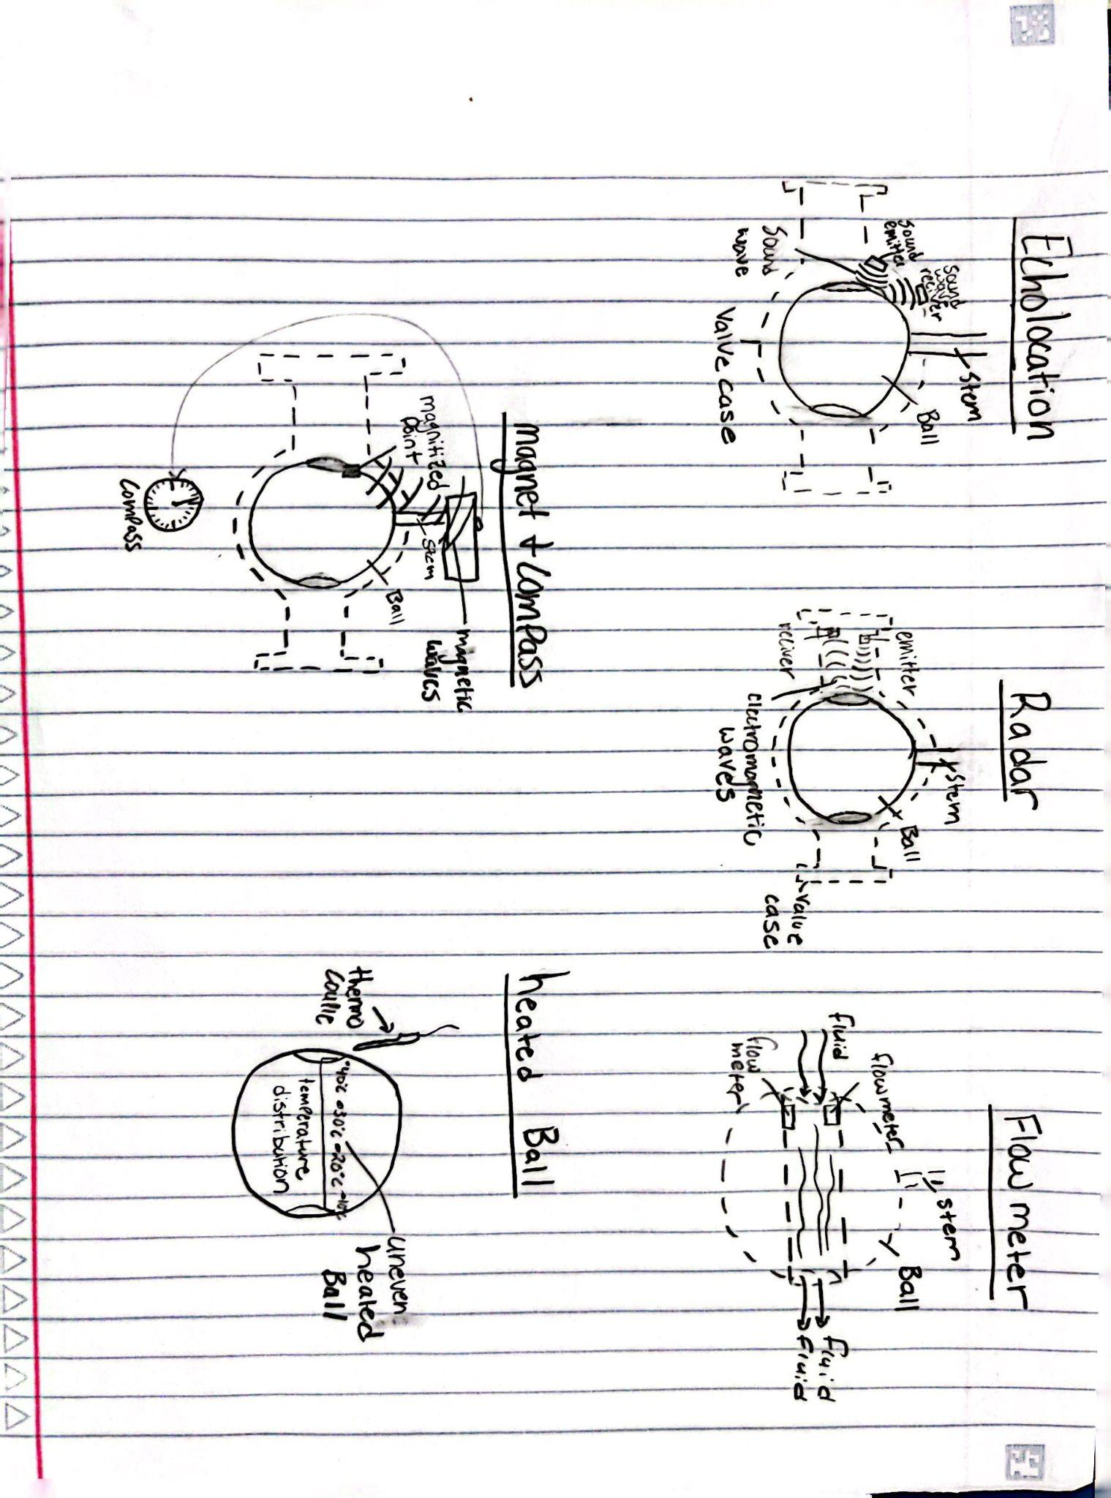
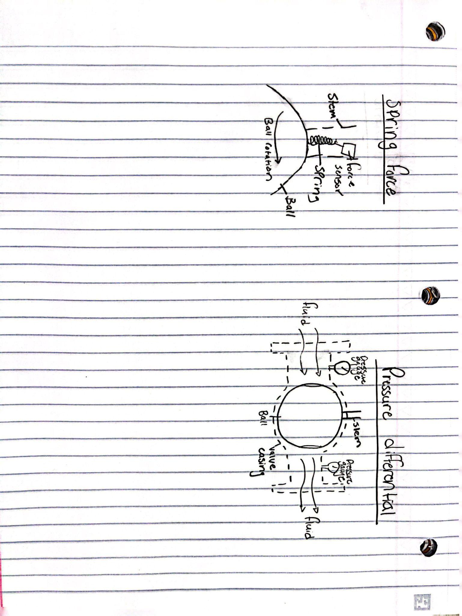
Idea Generation - Design by Analogy
Synonyms for position:
Location
Orientation
Rotation
Location ideas
Echolocation
Radar
Flow meter
Orientation Ideas
Magnet & Compass
Heated Ball
Rotation Ideas
Spring force
Pressure differential
Notes:
Locke

Slide 17
Morphological Matrix
Generate ideas for each sub function, then combine to create one concept.
Categories based off function chains.
Input Electricity | Measure Torque | Read Position | Embed System | Transmit data
Outlet Power | Torque Bracket | Potentiometer | Casing for Valve | Ethernet
Battery Powered | Rotational Torque Sensor | Hall Effect Probe | Independent Casing | Internet
Solar/ Renewably powered | Washer Strain Gages | Flow meters | Casing for actuator | Light Indicator
 | Force Sensors | Magnetic Fields |  | Sound Indicator
Concept: Embed a rotational torque sensor within actuator casing with Data Acquisition. When the actuator is toggled, the rotational torque sensor measures the applied force. A calibrated potentiometer applied to the ball of the valve (Wired to DAQ inside actuator casing) detects the exact change in potential of the system as the stem rotates, and determines the true position.
Notes:
Avery

Slide 18
Design Refinement - Position
VALVE POSITION | Imp | Measure turbulence at interface | Potentiometer | Pinholes in the Ball valve | Inductive proximity sensor | Echolocation | Radar | Flow meter | Magnet and Compass | Thermal detection of non-uniformly heated sphere | Spring Force | Pressure difference
Measurement Accuracy | 0.2 | Datum | 1 | -1 | 2 | -2 | -2 | 0 | 0 | -2 | -1 | -1
Embedded | 0.1 | Datum | 0 | 2 | 0 | 1 | 1 | 0 | 1 | 0 | 1 | -1
Scalable | 0.1 | Datum | -1 | 1 | -1 | 0 | 0 | 0 | 2 | 0 | 1 | 2
Contact with fluid | 0.05 | Datum | 2 | -2 | 2 | 0 | 0 | 0 | 1 | -2 | 1 | 0
Impact on performance | 0.15 | Datum | 2 | -2 | 1 | 1 | 1 | 1 | -1 | 0 | -1 | 1
Ease of implementation | 0.1 | Datum | -1 | -1 | -2 | -2 | -2 | 1 | -1 | -2 | -1 | 1
Calibration time | 0.05 | Datum | -1 | -1 | -1 | -1 | 0 | 0 | 2 | -2 | 0 | -1
Cost | 0.125 | Datum | 0 | 0 | -1 | -2 | -2 | 0 | 0 | -1 | 2 | 1
Lifetime of the sensor | 0.125 | Datum | 2 | -1 | 1 | 0 | 0 | 0 | 0 | -1 | -1 | 1
 | SUM | Datum | 4 | -5 | 1 | -5 | -4 | 2 | 4 | -10 | 1 | 3
Notes:
Locke

Slide 19
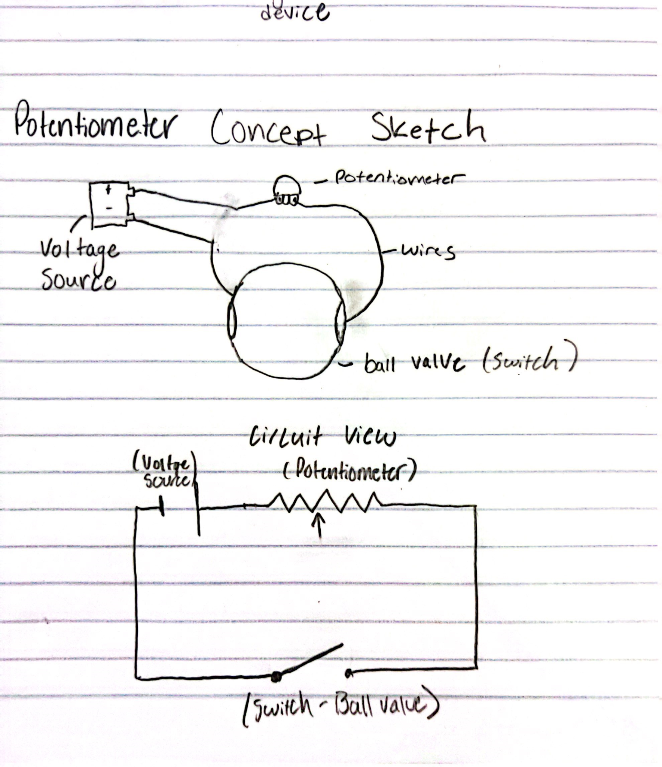
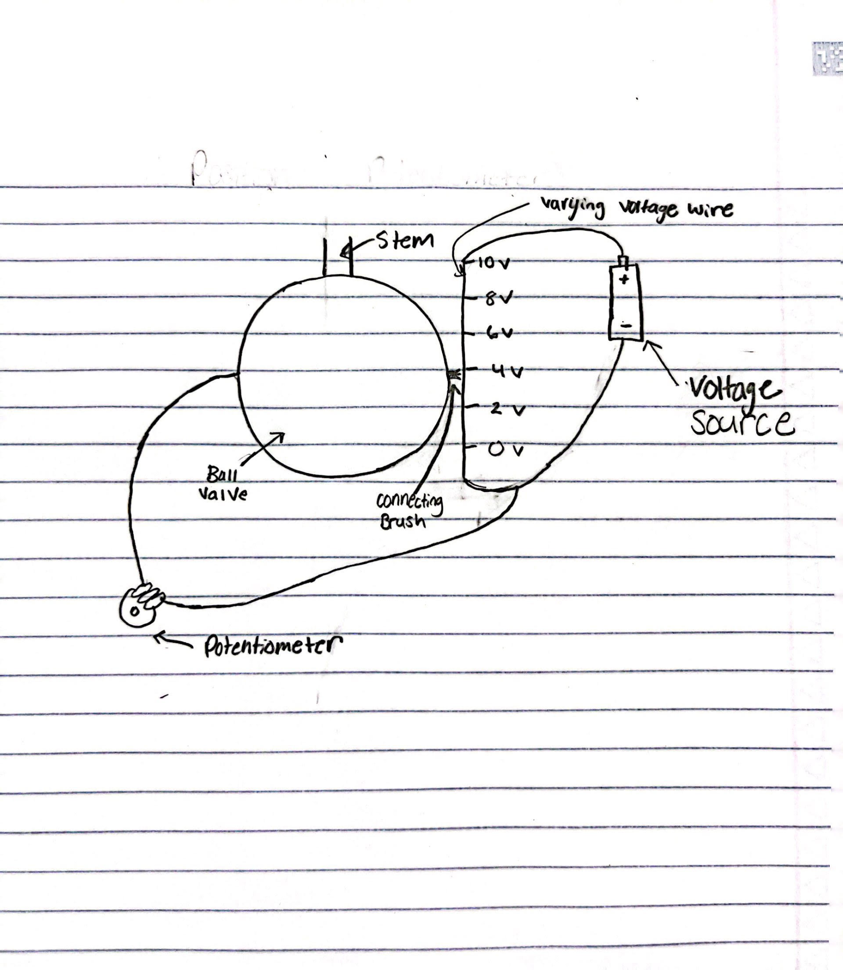
Concept Refinement - Potentiometer
1st iteration concept sketch
Selected as a concept due to low accuracy of 1 %, and low cost
1st iteration could only measure on off control
Concept iteration 2: measure full rotation of the ball
Added more moving parts so calibration and maintenance will take longer
Refined 2nd iteration concept sketch

Slide 20
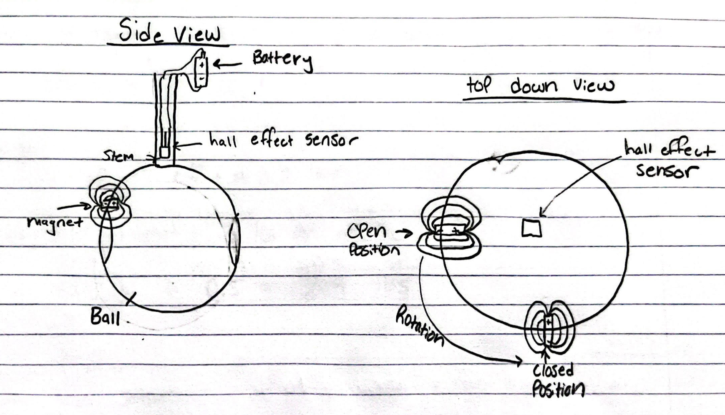
Concept Refinement - magnet and compass
Selected due to minimal contact of the sensor.
Concern: accuracy of the compass
Similar design but using a hall effect sensor
Hall effect sensor has greater accuracy and is small enough to be embedded in the stem
Hall effect sensor takes more power for a higher accuracies
Refined Concept: Hall effect sensor

Slide 21
Design Refinement - Torque
TORQUE | Importance | Cylindrical Strain Gauge | Encoder connected to gear | Spring Scale | Lidar to measure distance of sliding pin | Potentiometer
Measurement Accuracy | 0.2 | Datum | 1 | -3 | 2 | 0
Embedded | 0.1 | Datum | -1 | 0 | -2 | 1
Scalable | 0.1 | Datum | 0 | 0 | -1 | -1
Impact on performance | 0.15 | Datum | 0 | -1 | 2 | -1
Ease of implementation | 0.1 | Datum | -2 | 2 | -1 | 0
Calibration time | 0.05 | Datum | -1 | -1 | 0 | 1
Cost | 0.15 | Datum | -2 | 2 | -2 | 0
Lifetime of sensor | 0.15 | Datum | 2 | -2 | 0 | 1
 | SUM | Datum | -3 | -3 | -2 | 1
Notes:
Avery

Slide 22
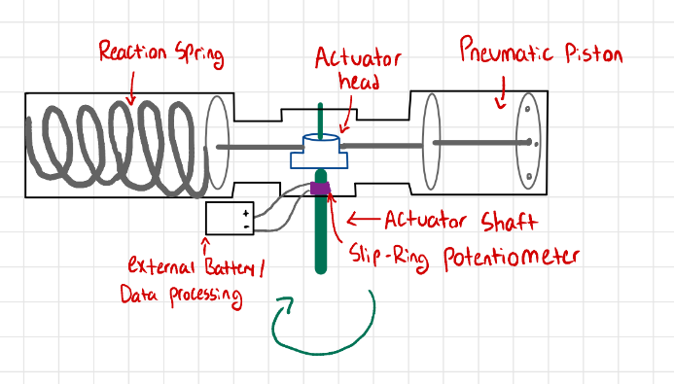
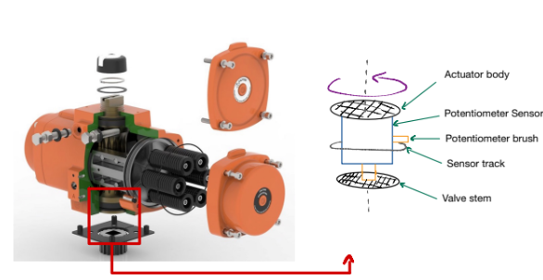
Concept Refinement - Potentiometer
Retains accuracy of 1%, low cost for the sensor, easy to implement
Exact placement depends on valve type, use a slip-ring potentiometer
Calibrate voltage changes to speeds, determine angular acceleration
𝜏 = I𝜶, assuming the moment of inertia can be determined

Slide 23
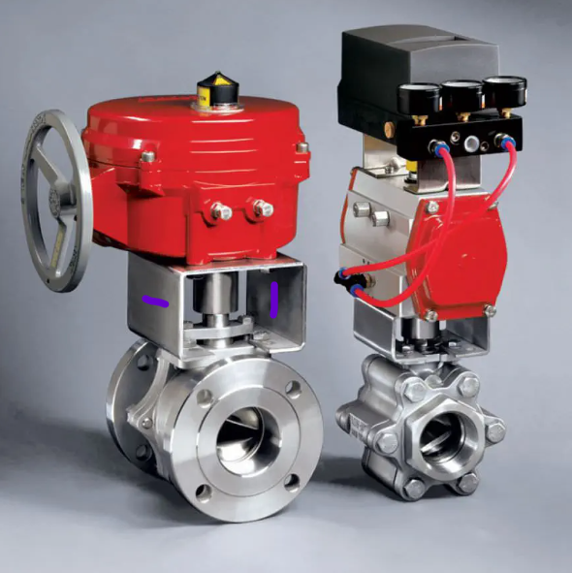
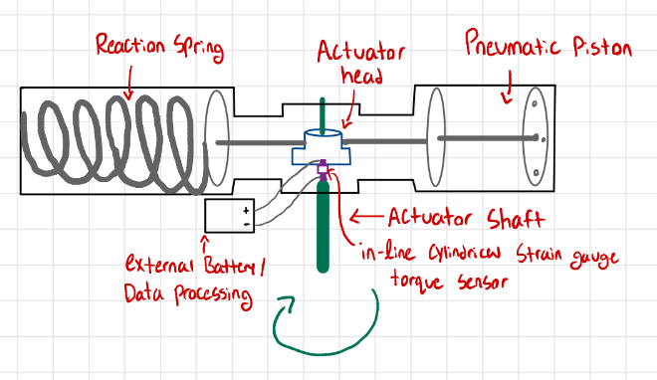
Concept Refinement - Strain Gauge
Uses force, rather than dynamics, to measure Torque
Retains high accuracy (1% of full value), long usage life
Move strain gauge inline to actuator shaft, close to torque source (Actuator head)
Use cylindrical strain gauge (Rotational torque sensor)
Returns maximum torque
Possibly challenging to implement
Existing Torque Bracket Solution, Strain gauges applied to the external bracket to measure reaction torques

Slide 24
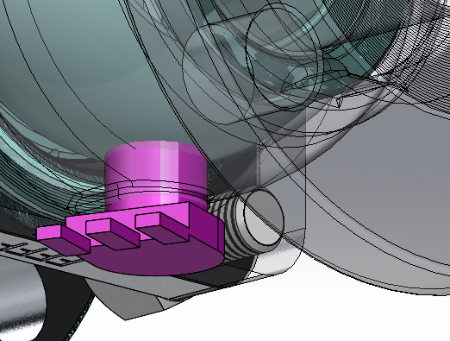
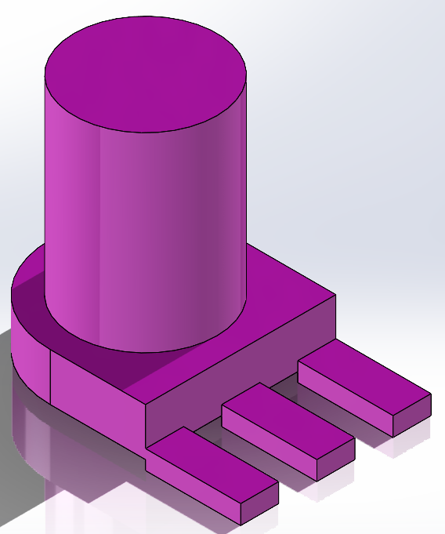
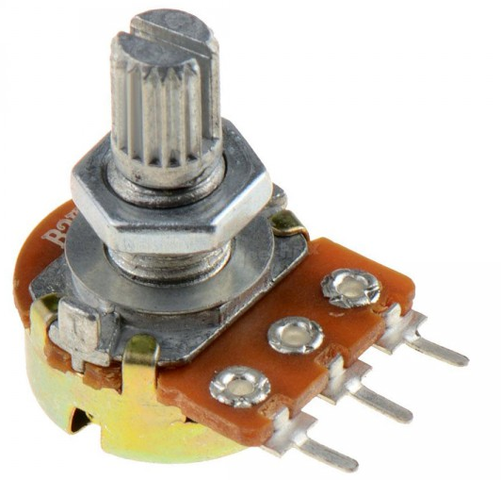
Concept Selection - Position
Potentiometer
Attach rotary potentiometer under the ball
Low cost, easy implementation, and embedded
Notes:
Cody -
our final concept for determining the valve position is a rotary potentiometer
As the ball rotates, a connected rod in the potentiometer will rotate as well, which changes the amount of current in the circuit it is attached to
The device will be placed under the ball of the valve, and this will not compromise the function of the valve
Potentiometers have a low cost, are easily implemented, and achieve our deliverable of being fully embedded

Slide 25
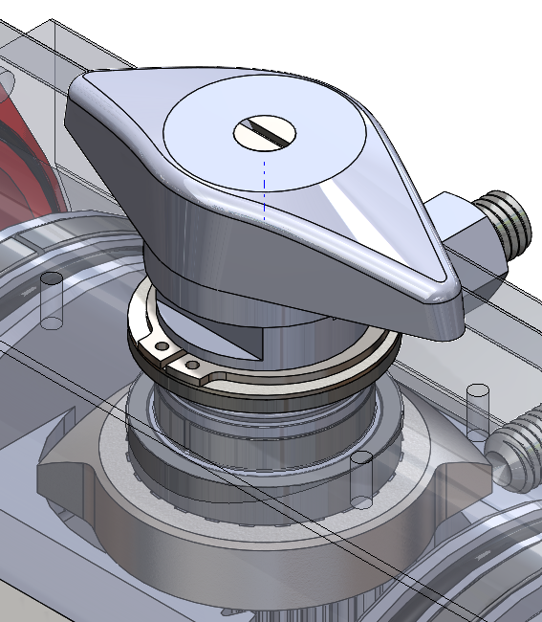
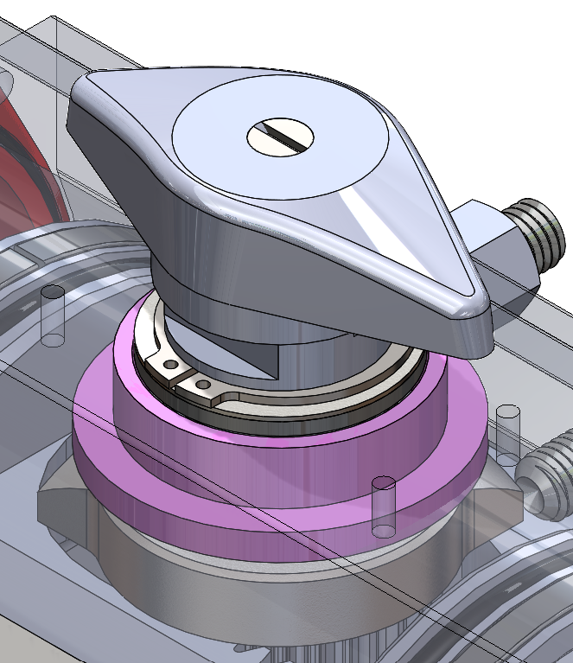
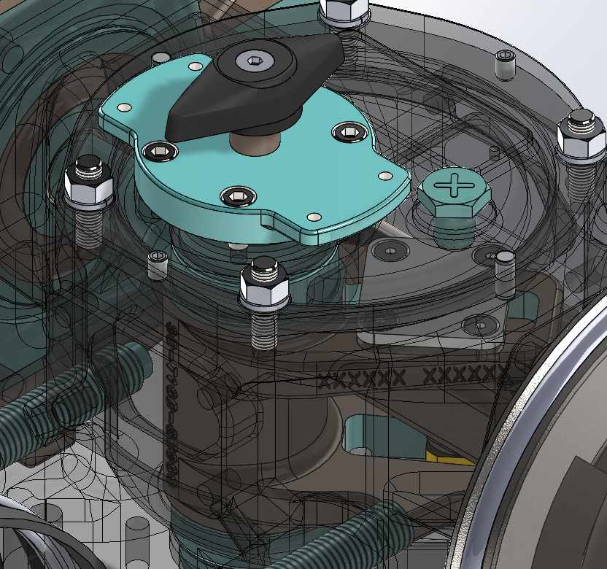
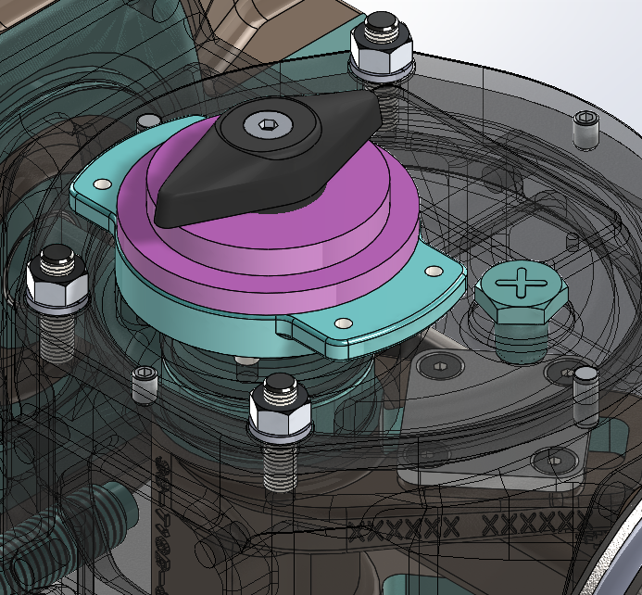
Concept Selection - Torque
Potentiometer
Attach rotary potentiometer on top of actuator shaft
Low cost, easy implementation, and embedded
Rack and Pinion
Scotch - Yoke
Notes:
Cody
Similarly to the valve position concept, we will use a rotary potentiometer to determine the actuator output torque
Again, this is a low cost, easily implemented solution
Here you can see there is a viable space to implement the potentiometer on the top of the actuator shaft for both styles of actuators
By using similar sensors on both the valve and actuator, it will reduce complexity in powering both sensors and make translating raw data easier

Slide 26
Concept Selection
Quantitative Matrix
Metrics | Importance | Hall effect sensor | Potentiometer (position) | Rotational Torque Bracket | Potentiometer (torque) | Force sensor
Measurement Accuracy (% uncertainty) | 0.5 | 3% to 1% | 0.01% | 0.5 % | 2.00% | 3%
Calibration Time (sec/min) | 0.1 | 110 min | 80 min | 90 min | 30 min | 15 min
Cost ($) | 0.05 | $549.00 | $136.00 | $2,900.00 | $125.00 | $150.00 (need 2)
Lifetime of sensor (years or cycles) | 0.1 | 10 million cycles | 1-20 million cycles | 100 million cycles | 1-20 million cycles | 1-10 million cycles
Volume of apparatus (in³) | 0.05 | 12 | 4.825 | 5.88 | 8 | 5
Weight of apparatus (lbs) | 0.03 | 2.9 lbs | .5 lbs | 1.1 lbs | 2.5lb | 1
Ease of manufacturing (# of parts) | 0.1 | 4 | 2 | 5 | 2 | 3
Ease of maintenance (# of moving parts) | 0.07 | 0 | 2 | 2 | 1 | 0
Notes:
Cody
Our quantitative matrix was a large reason why we chose the potentiometer concepts
In both locations, the potentiometers have less error than required by Bray
Furthermore, potentiometers were the most cost effective solution, could both handle up to 20 million cycles, and are easy to manufacture and maintain

Slide 27
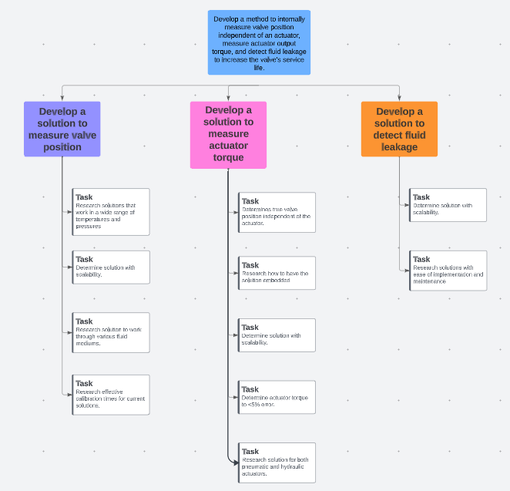
Scheduling and Managing a Project
Work Breakdown Structure
Notes:
Micheal

Slide 28
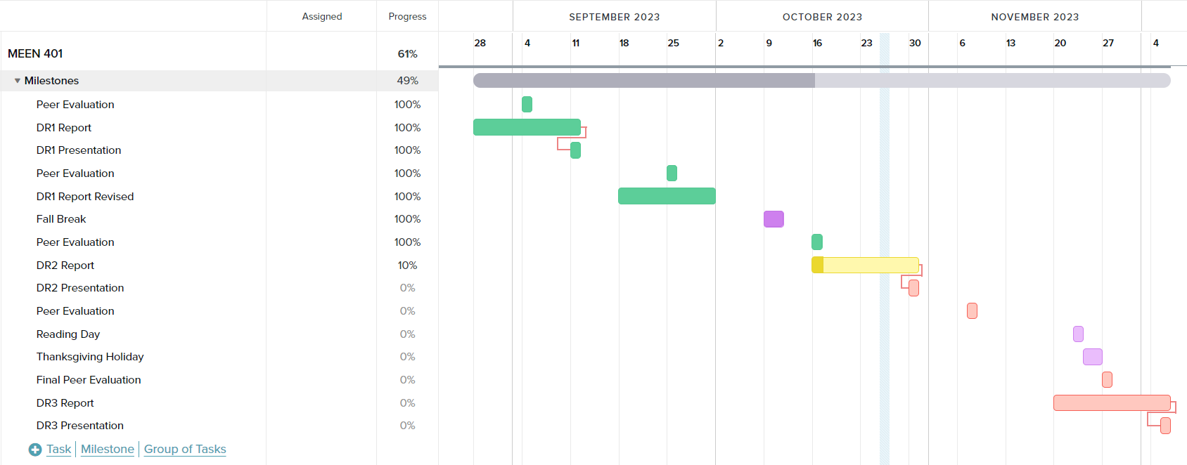
Scheduling and Managing a Project
Gantt Chart

Slide 29
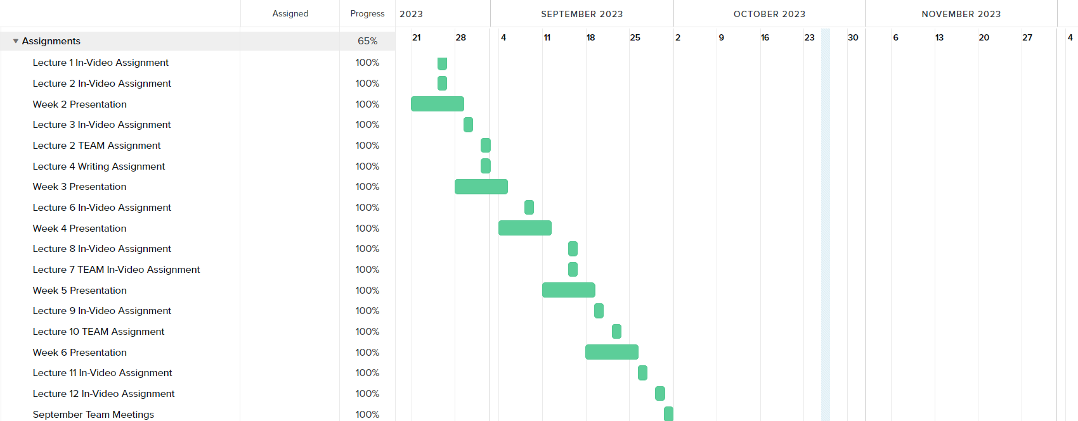
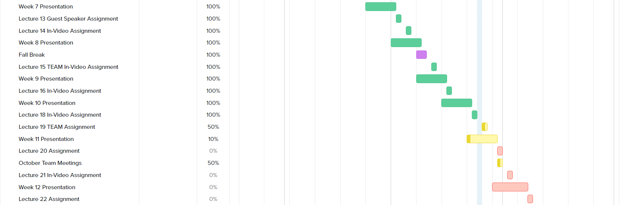
Scheduling and Managing a Project

Slide 30
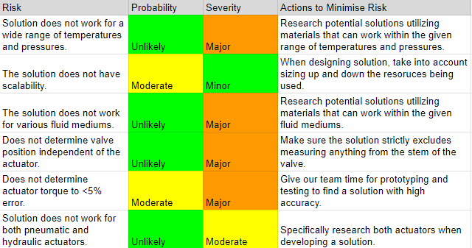
Scheduling and Managing a Project
Process Risk Assessment

Slide 31
Final Deliverables
Provide a comprehensive solution for detecting valve positions and internal actuator torque
Scalable to varying actuator and valve sizes
Solution is cost-effective and safe for the user
Focus on the potentiometer as our solution
Collaborate with Bray to 3D-print prototypes of our solution, which will undergo testing with their valves and actuators
Adhere to milestones and deadlines, allowing us to provide effective material for our upcoming reports
Notes:
micheal

Slide 32
Future Work
DR3 Deliverables
Embodiment Design
Product Architecture
Definitive Layout
Risk Analysis
Budget Planning (BOM)
Validation Plan for MEEN 402
Minimal viable product
Plan key milestones through completion with Bray
Notes:
Travis - DR3, minimal viable product, etc.

Slide 33
Conclusion
Torque and position problems are the focus
Potentiometer solution for both torque and position problem
Work with Bray to select exact sensor, vendor, power method, etc.
Notes:
Zack

Slide 34
Questions?

Slide 35
References
“Piping Codes and Valve Standards”. Valve Magazine, September 29, 2015,
https://www.valvemagazine.com/articles/piping-codes-and-valve-standards. Accessed 25 October 2023.
“Fluid Power Actuators Explained”. Rotork Fluid Systems, May 2016, https://www.rotork.com/uploads/documents-versions/24733/1/pub010-024-00_0516.pdf. Accessed 11 September 2023.
“Pneumatic Actuator: Series 92/93 Rack & Pinion Pneumatic”. Bray International, Inc, n.d., https://www.bray.com/valves-actuators-controls/actuators/pneumatic-actuator/series-92-93-pneumatic-actuator. Accessed 11 September 2023.
“Scotch Yoke Pneumatic Actuator: Series 98”. Bray International, Inc, n.d., https://www.bray.com/valves-actuators-controls/actuators/pneumatic-actuator/series-98-scotch-yoke-pneumatic-actuator. Accessed 11 September 2023.
“Mark-10 MTT03C-100 Hand-held Cap Torque Meter CAP-TT03-100”. ABQ Industrial, n.d., https://www.abqindustrial.net/store/mark-10-mtt03c-100-hand-held-cap-torque-meter-cap-tt03-100-100-lbf-in-capacity-p-807-op-1306_4671.html. Accessed 25 October 2023.
“Torque Sensor - Valve Torque Testing”. Futek Advanced Sensor Technology, n.d., https://www.futek.com/applications/Valve-Torque-Testing. Accessed 23 October 2023.
“A Comprehensive Guide on Butterfly Valve Vs Ball Valve”. Dombor Valve, 2021, https://www.dombor.com/ball-valve-vs-butterfly-valve/. Accessed 11 September 2023.
“Rotary Potentiometer - 10k Ohm, Linear”. Osoyoo, May 7, 2015, https://osoyoo.com/2017/05/07/rotary-potentiometer-10k-ohm-linear/. Accessed 29 October 2023.

